Slide 1
Retail-Giant Sales Forecasting Case Study SUBMISSION
Nageswara Reddy Kakarla - DDA1610191
Dijender Saini – DDA1610016
Vikas Rai –
PV Snehil -

Slide 2
Objective: To Forecast Sales and Demand For Next 6 Months
Data Highlights:
Sales transaction data is available for four(4) years
Each data point is a transaction
Attributes of Interest:
Segment
Market
Quantity sold
Value of the sale
Profit made on the sale
We have multiple markets and segments so we would focus on only top 5
Criteria for selection
Maximum profit
Consistent profit (based on profit %age month on month)

Slide 3
Problem Solving Approach Flow Chart
Business Problem Understanding
Understanding Data
Data Preparation
Data Cleansing
Feature Engineering
Consolidate data on Month for Analysis
Best market segment
Most Profitable
Most Consistent
Prepare Model that Closely Represents Trend and Seasonality
Smoothen the Curve Using Simple avg. or Weighted
Decompose and see the shape of trend and seasonality
Preparing Time Series data
Profit
Quantity
N
N
Check for Residue using ARIMA
Residue is pure noise
Other Tests Look Good
Y
Model is accepted
Use the model to predict future Quantity and Profit
Y
Run the model on test data and perform other tests

Slide 4
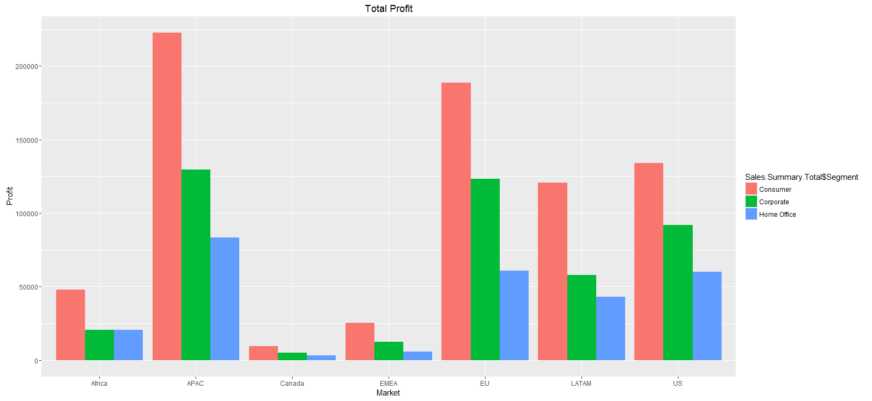
Selection of Top 5 Market Segments: By Total Profit

Slide 5
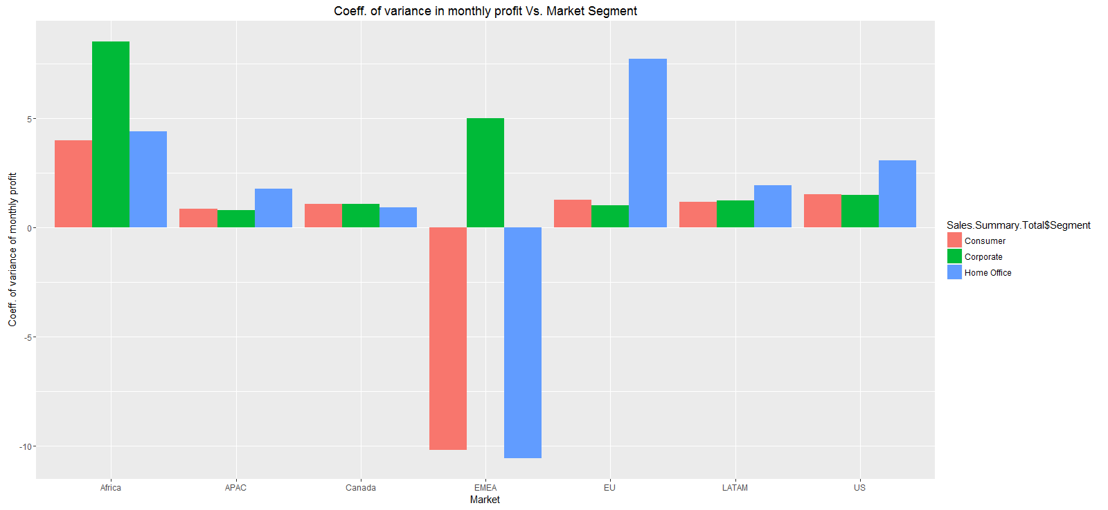
Selection of Top 5 Market Segments: By Consistent Profit
# 1. APAC Consumer
# 2. EU Consumer
# 3. APAC Corporate
# 4. EU Corporate
# 5. LATAM Consumer
Market | Segment | Total Profit | Sales Amount | # of Sales | Avg Monthly Profit% | Avg. Monthly Profit %age | Coeff. Of Variance of Monthly Profit %age
APAC | Consumer | 222817.56 | 1816753.7 | 5699 | 12.264599 | 12.42859 | 0.8269013
EU | Consumer | 188687.707 | 1529716.24 | 5186 | 12.334818 | 13.25015 | 1.2684336
US | Consumer | 134119.209 | 1161401.34 | 5191 | 11.54805 | 12.49422 | 1.4948927
APAC | Corporate | 129737.235 | 1078466.31 | 3283 | 12.02979 | 19.37571 | 0.7694441
EU | Corporate | 123393.98 | 920008.28 | 3077 | 13.412268 | 28.8629 | 1.0044941
LATAM | Consumer | 120632.932 | 1133847.03 | 5321 | 10.63926 | 15.19867 | 1.1512127

Slide 6
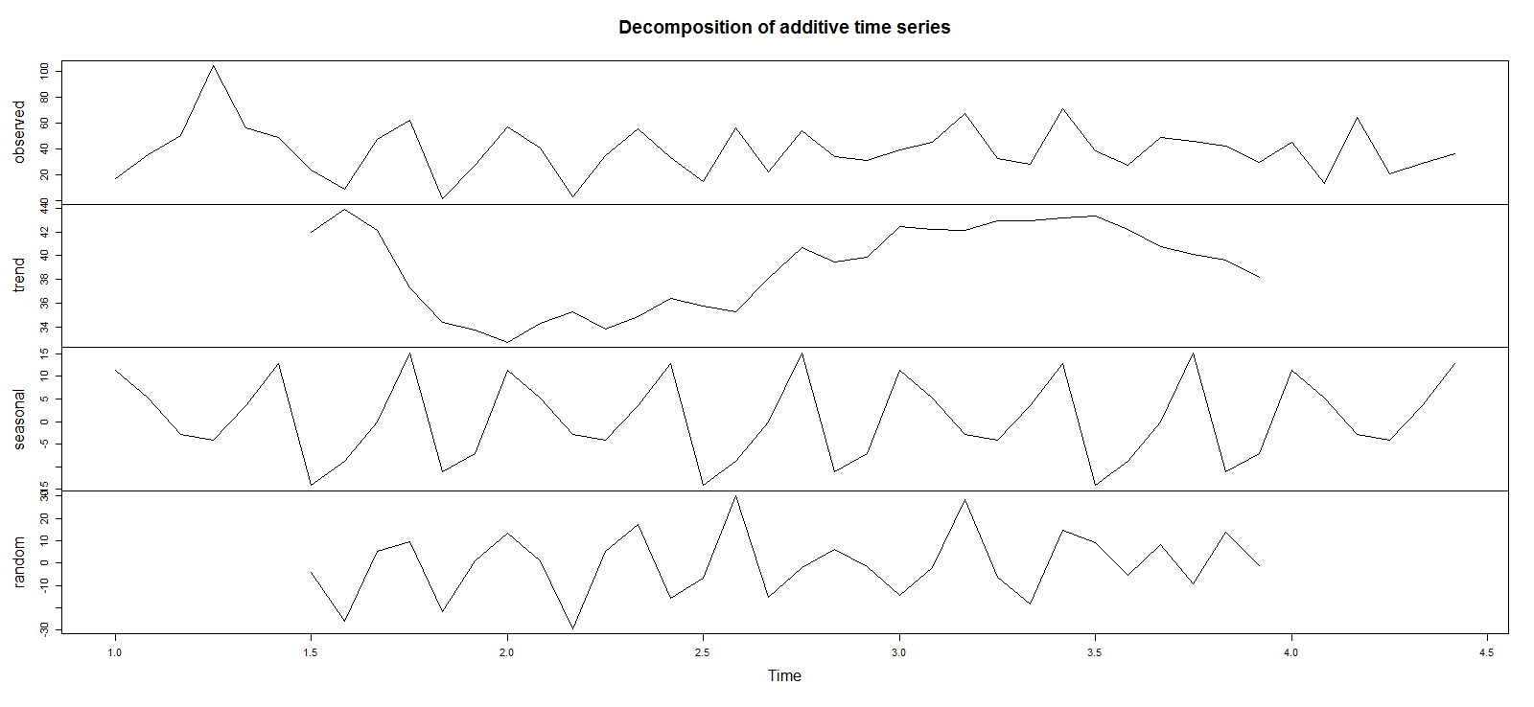
Model Plot : APAC Consumer Profit Decomposition Chart

Slide 7
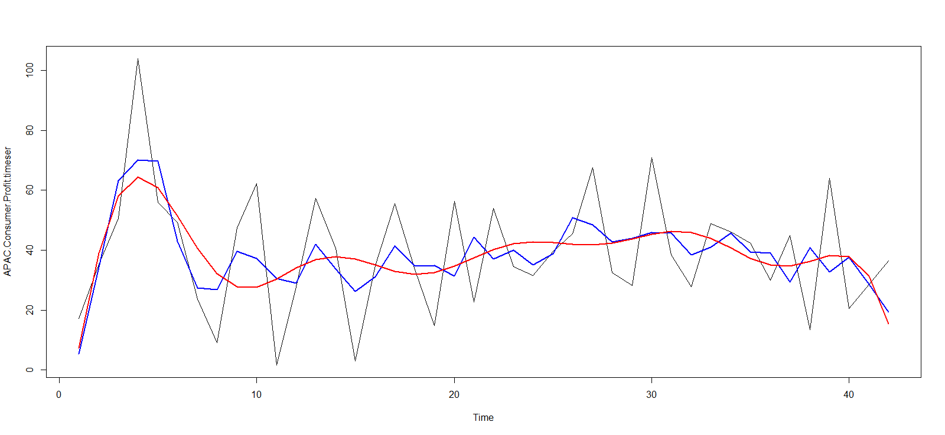
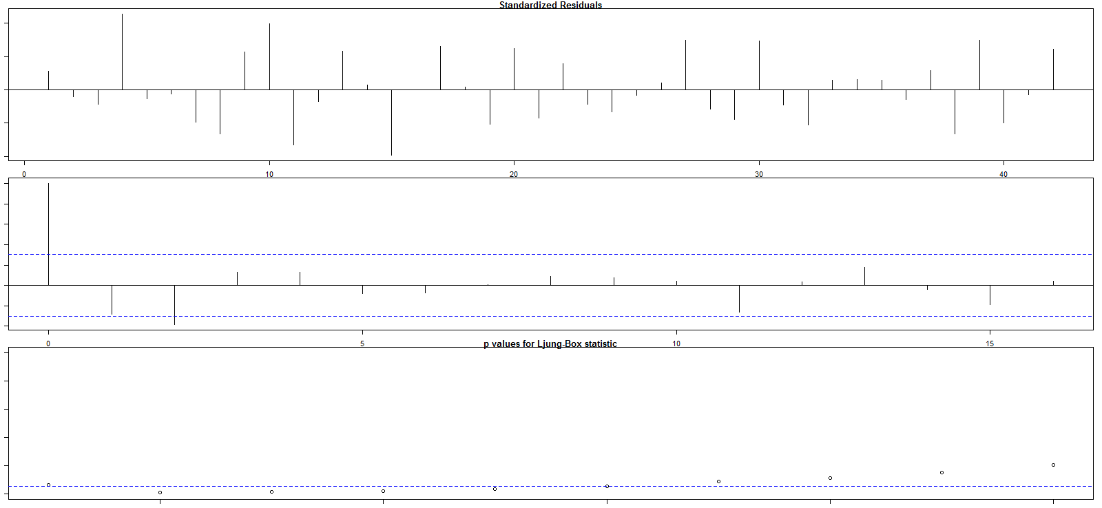
Model Plot : APAC Consumer Profit Curve fitting Residue analysis

Slide 8
Model Plot : APAC Consumer Quantity Decomposition Chart

Slide 9
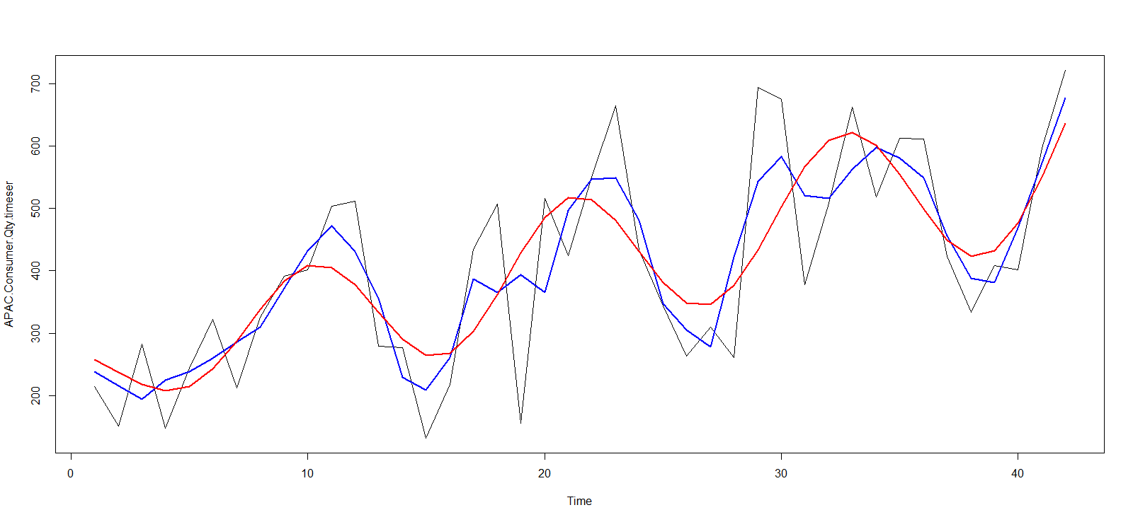
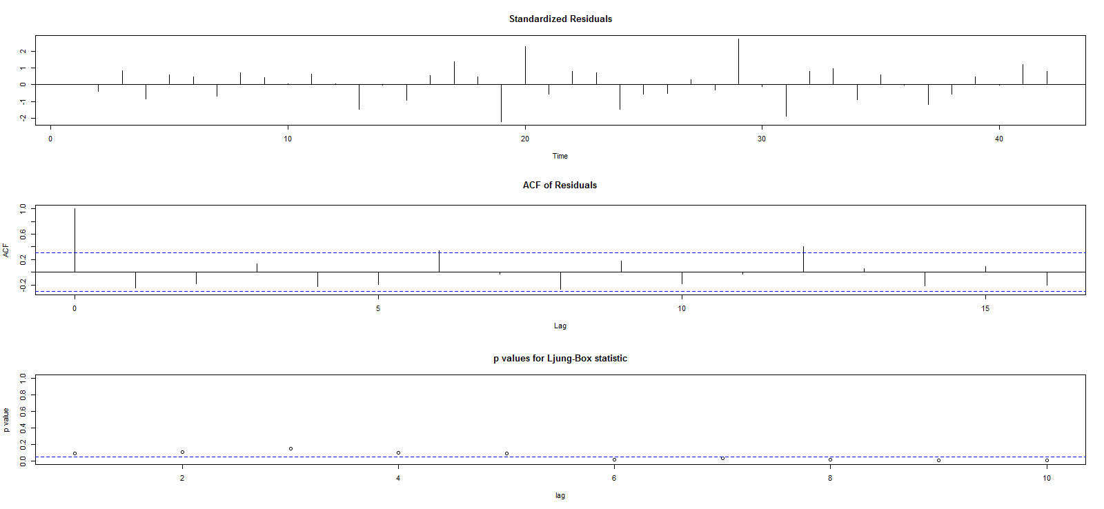
Model Plot : APAC Consumer Quantity Curve fitting Residue analysis

Slide 10
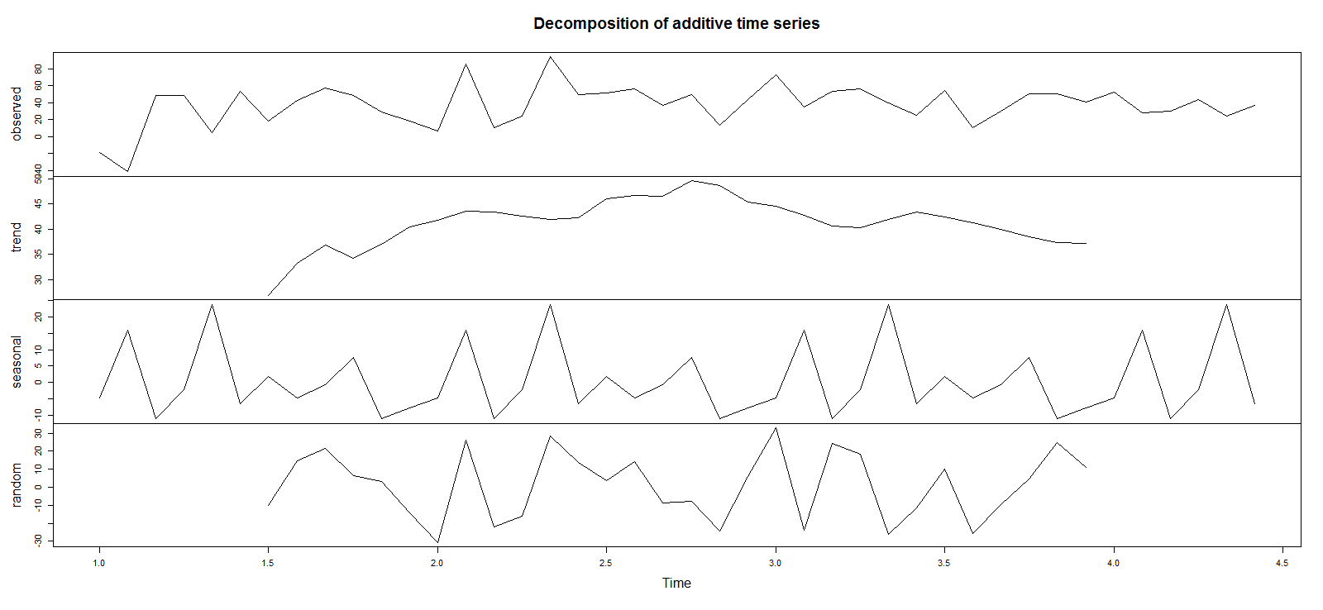
Model Plot : EU Consumer Profit Decomposition Chart

Slide 11
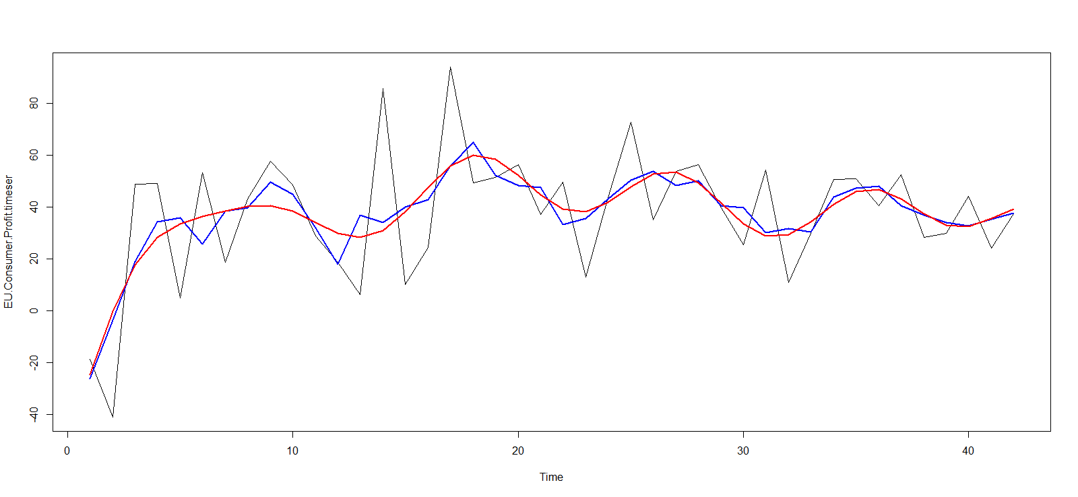
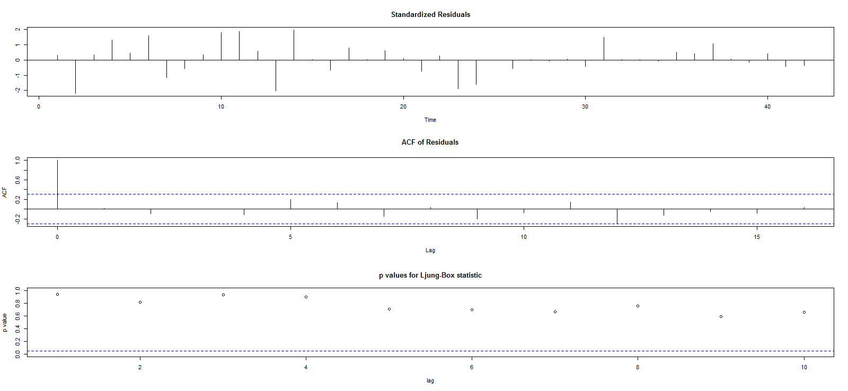
Model Plot : EU Consumer Profit Curve fitting Residue analysis

Slide 12
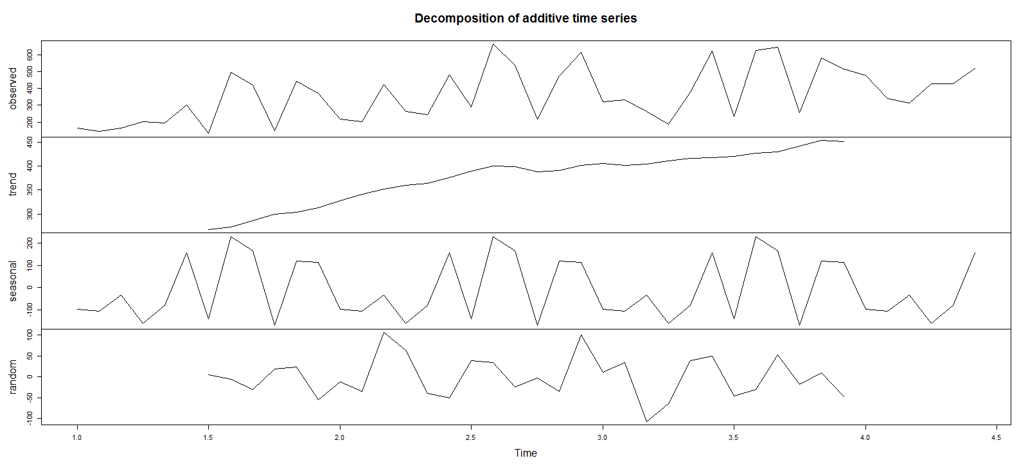
Model Plot : EU Consumer Quantity Decomposition Chart

Slide 13
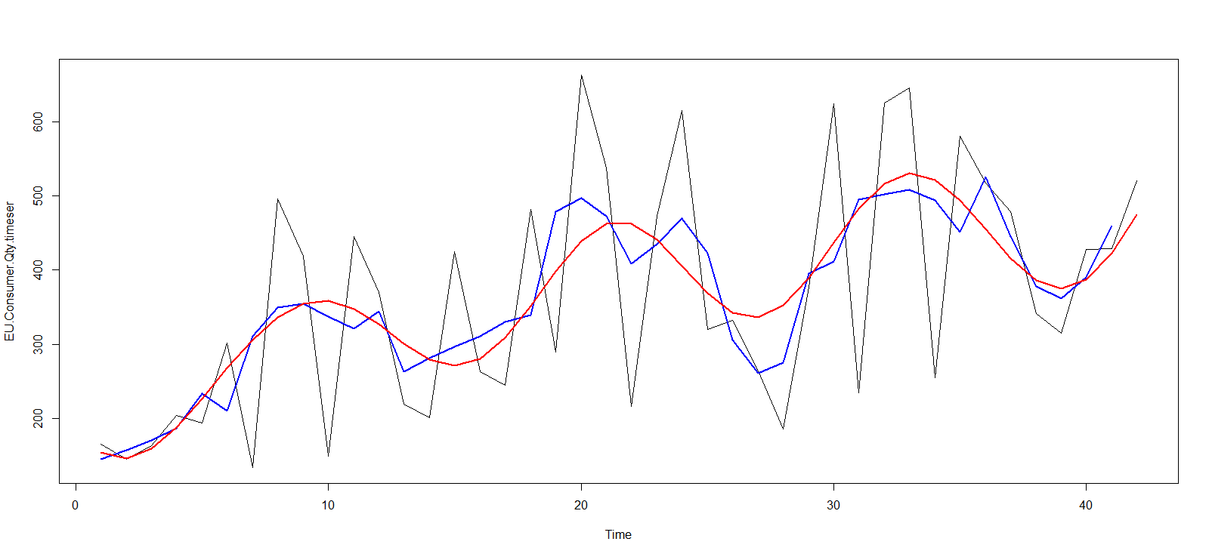
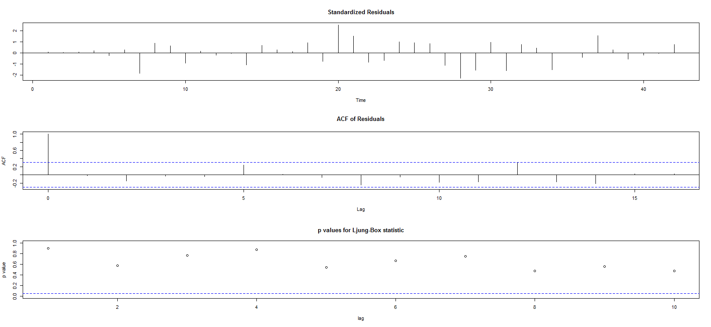
Model Plot : EU Consumer Quantity Curve fitting Residue analysis

Slide 14
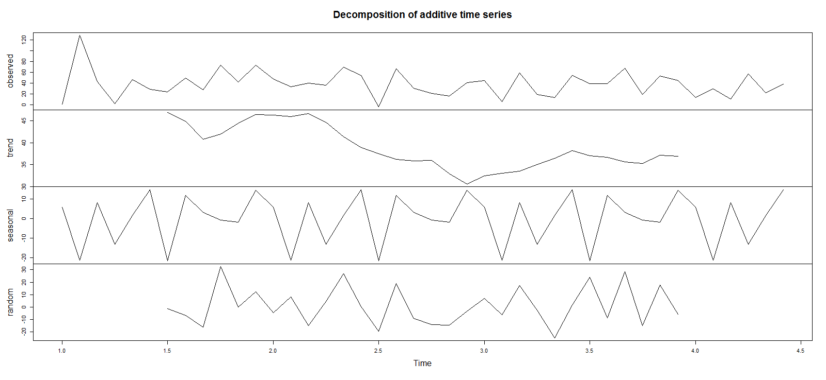
Model Plot : APAC Corporate Profit Decomposition Chart

Slide 15
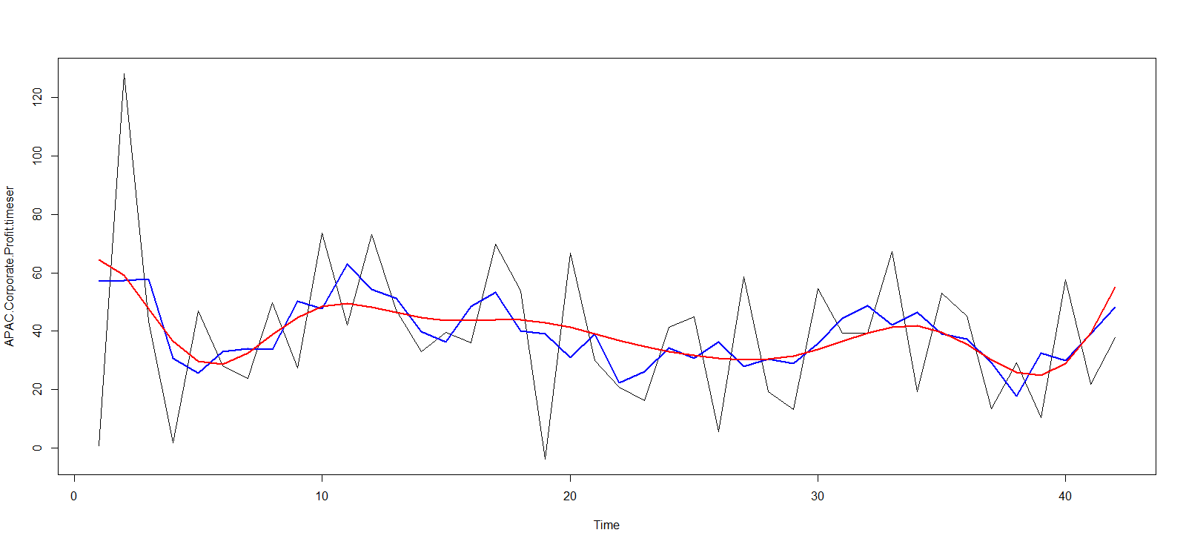
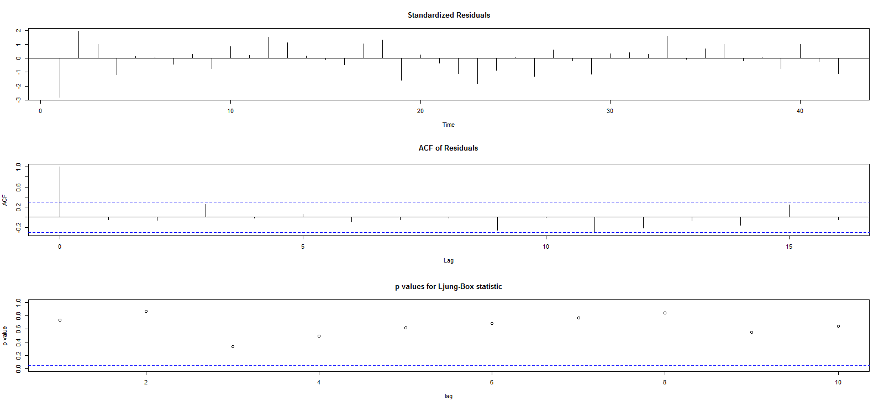
Model Plot : APAC Corporate Profit Curve fitting Residue analysis

Slide 16
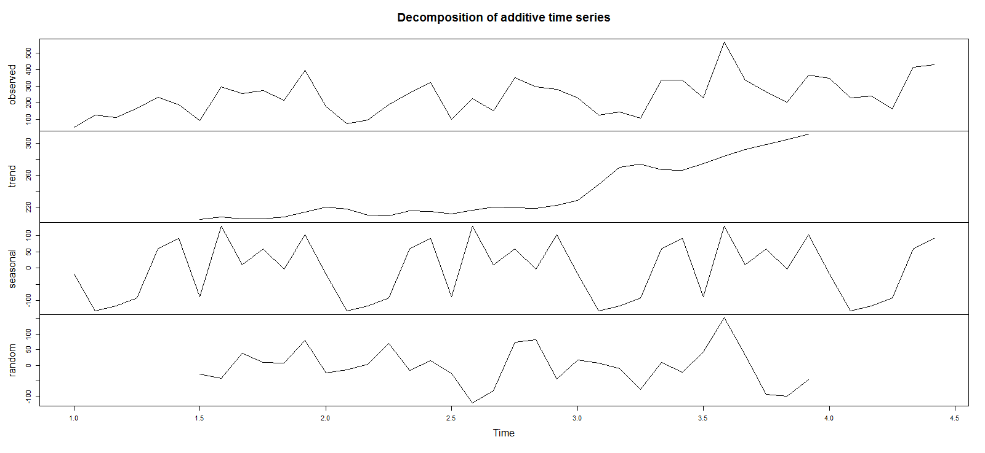
Model Plot : APAC Corporate Quantity Decomposition Chart

Slide 17
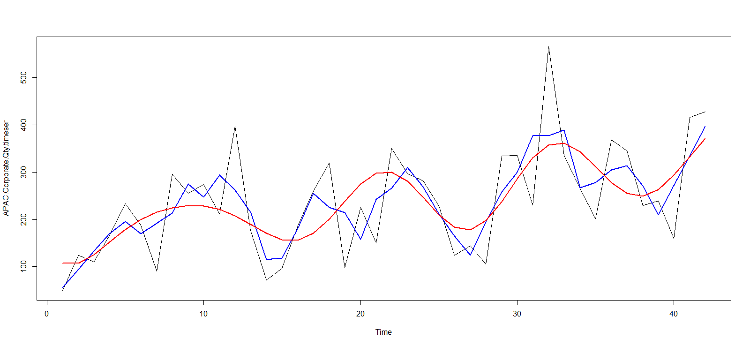
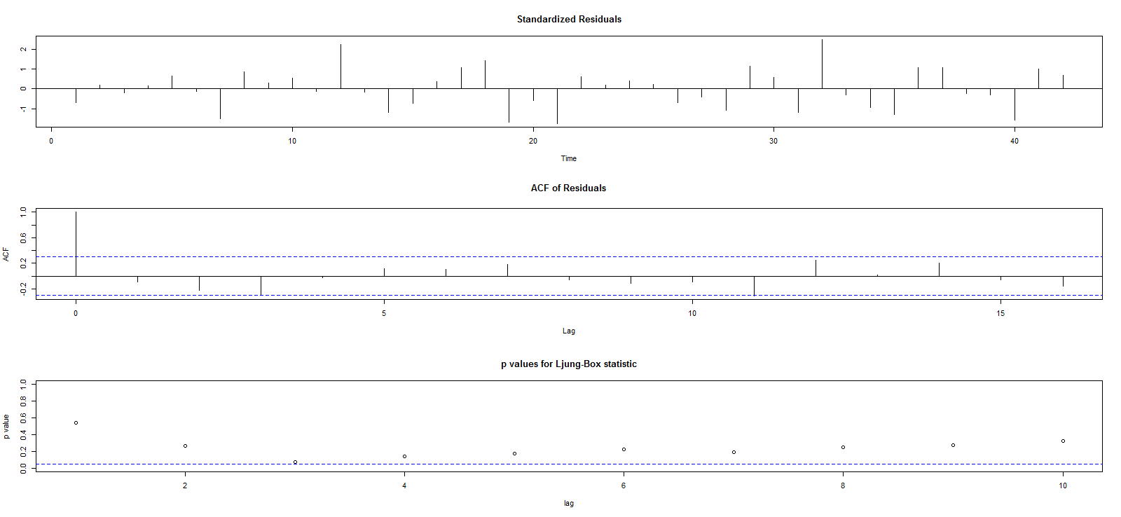
Model Plot : APAC Corporate Quantity Curve fitting Residue analysis

Slide 18
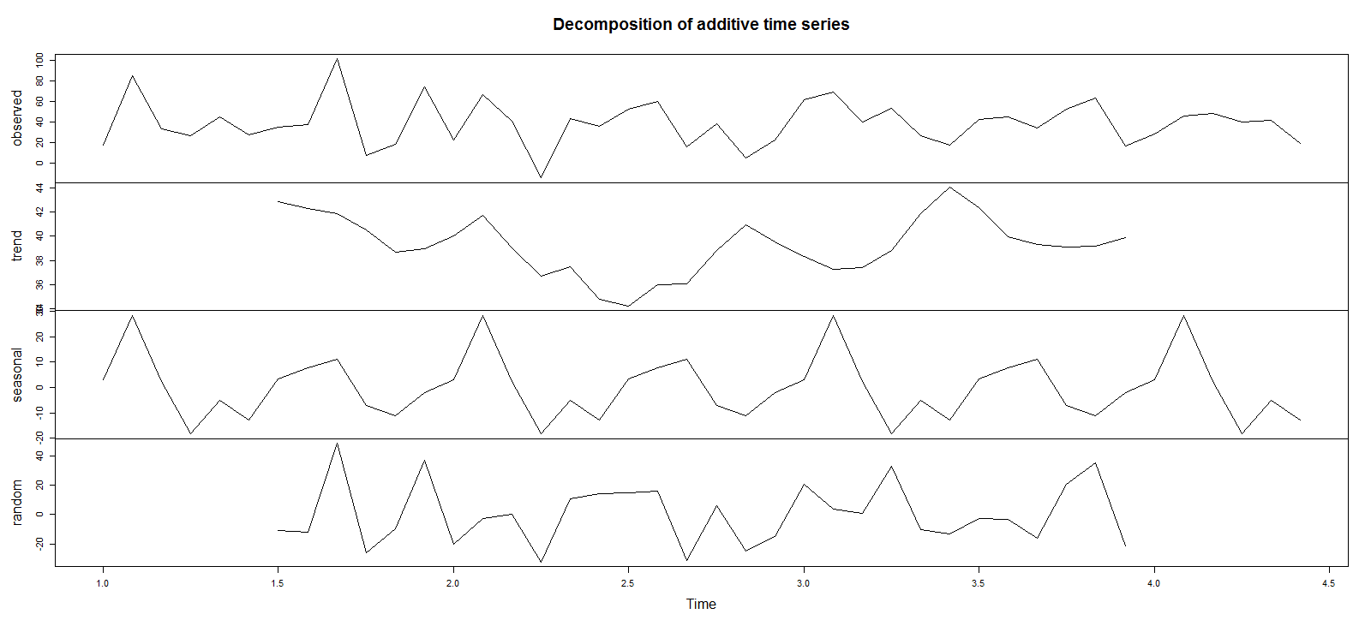
Model Plot : EU Corporate Profit Decomposition Chart

Slide 19
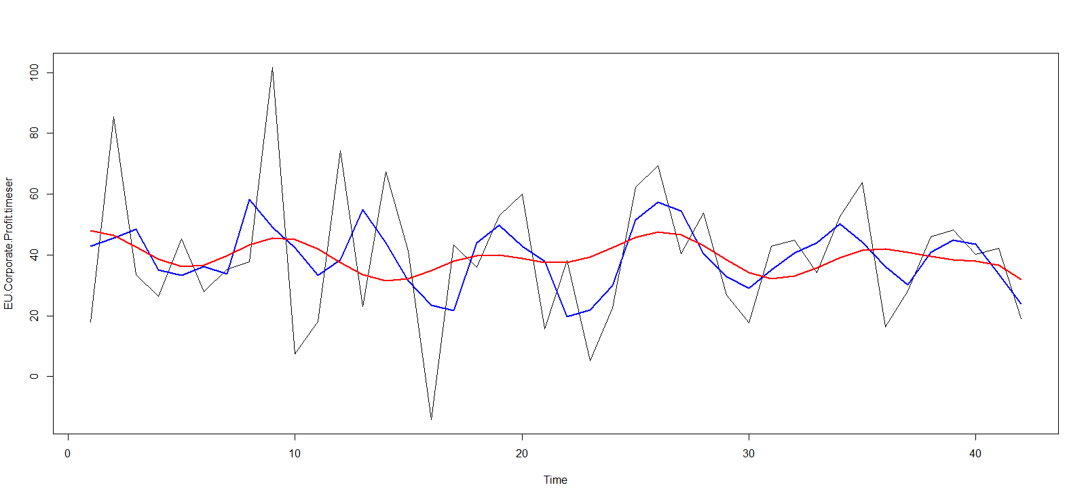
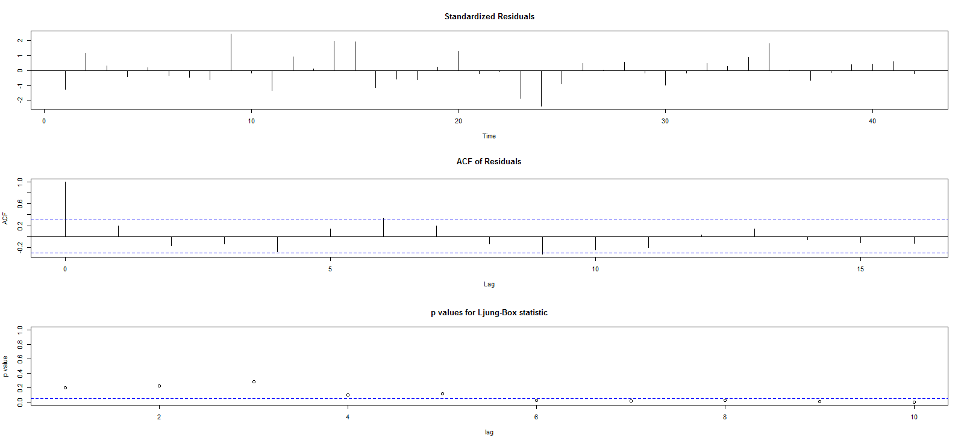
Model Plot : EU Corporate Profit(Check) Curve fitting Residue analysis

Slide 20
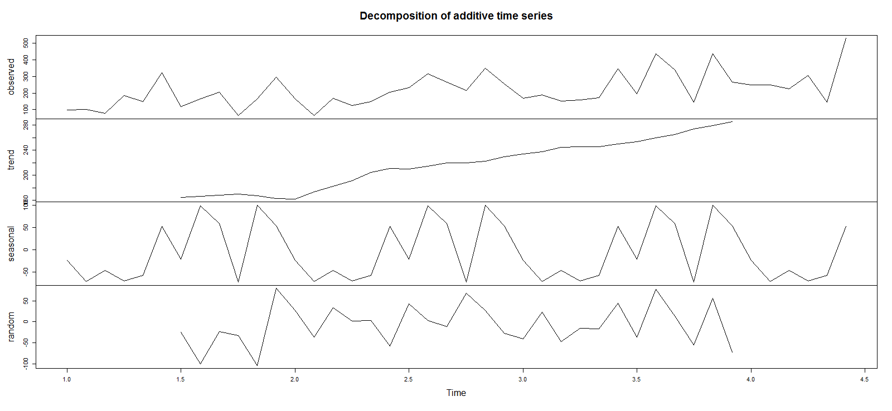
Model Plot : EU Corporate Quantity Decomposition Chart

Slide 21
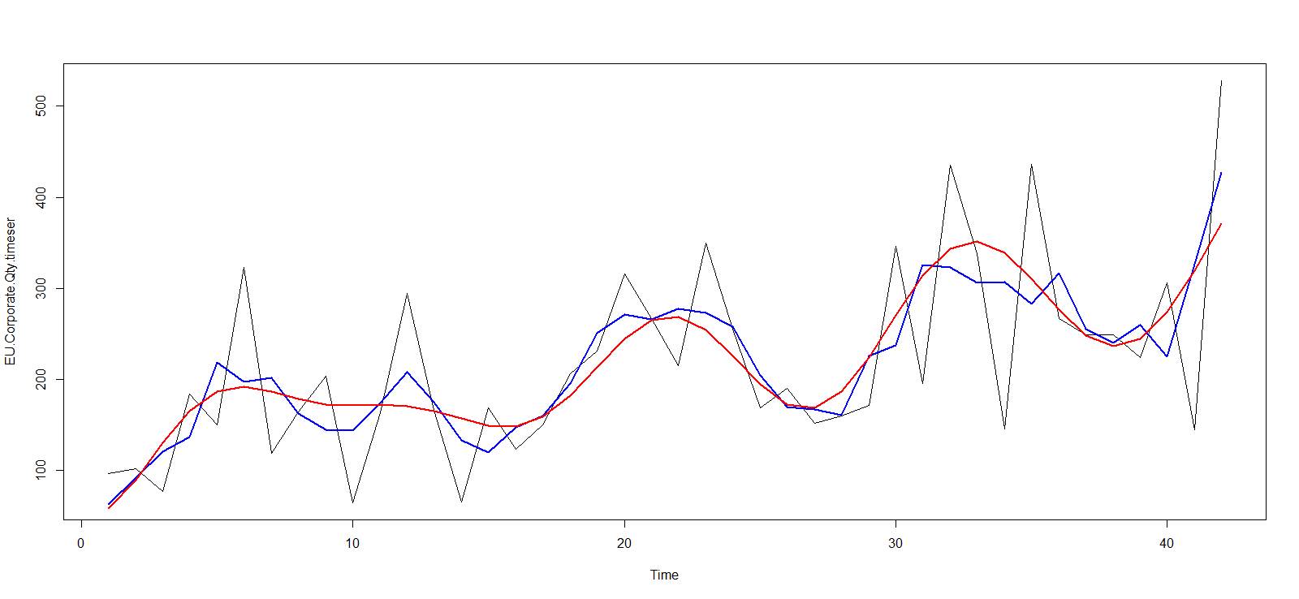
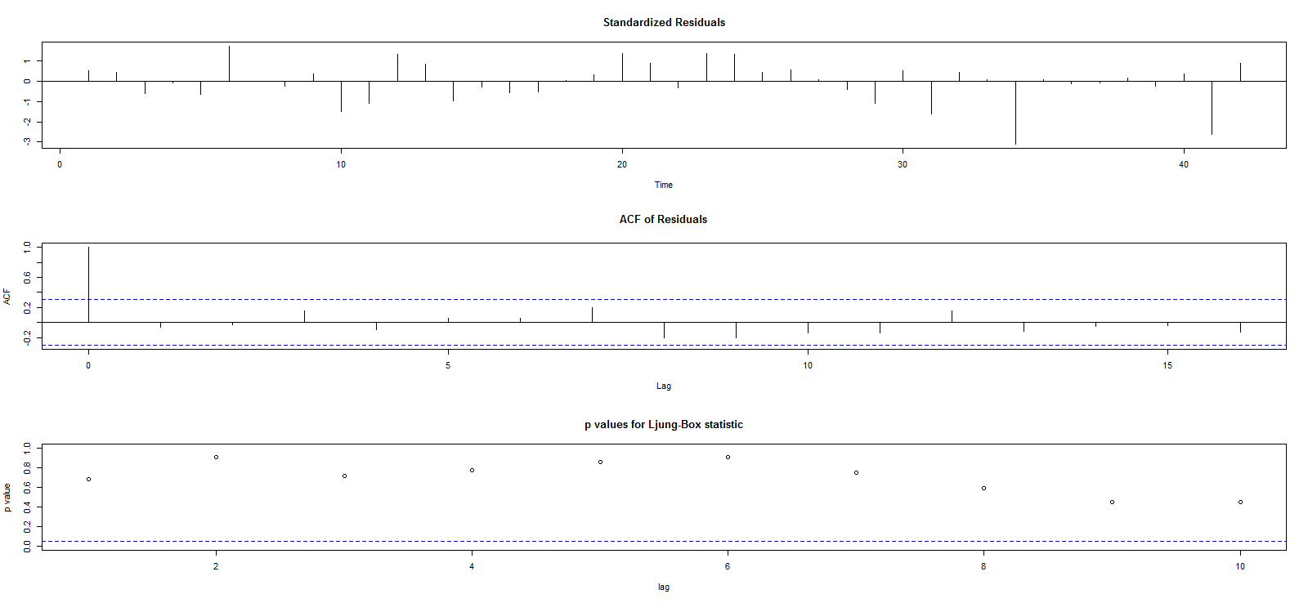
Model Plot : EU Corporate Quantity(Check) Curve fitting Residue analysis

Slide 22
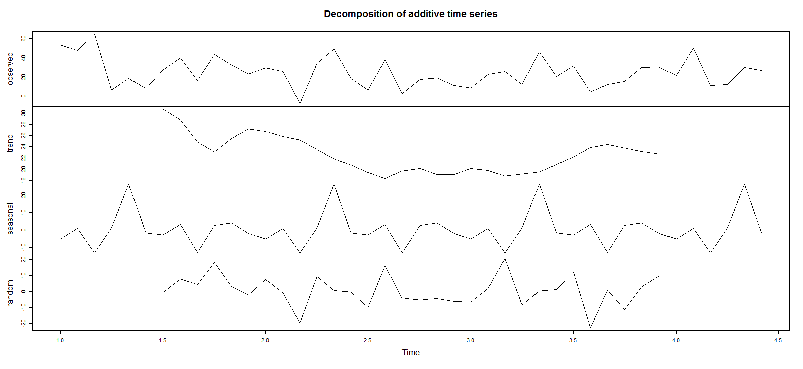
Model Plot : LATAM Consumer Profit Decomposition Chart

Slide 23
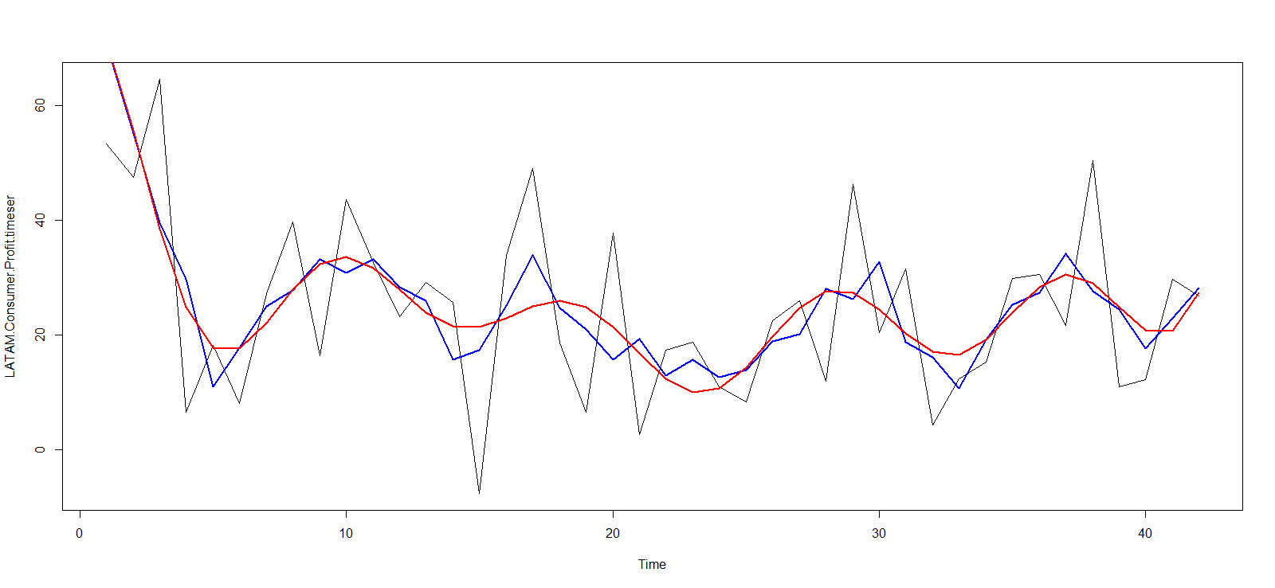
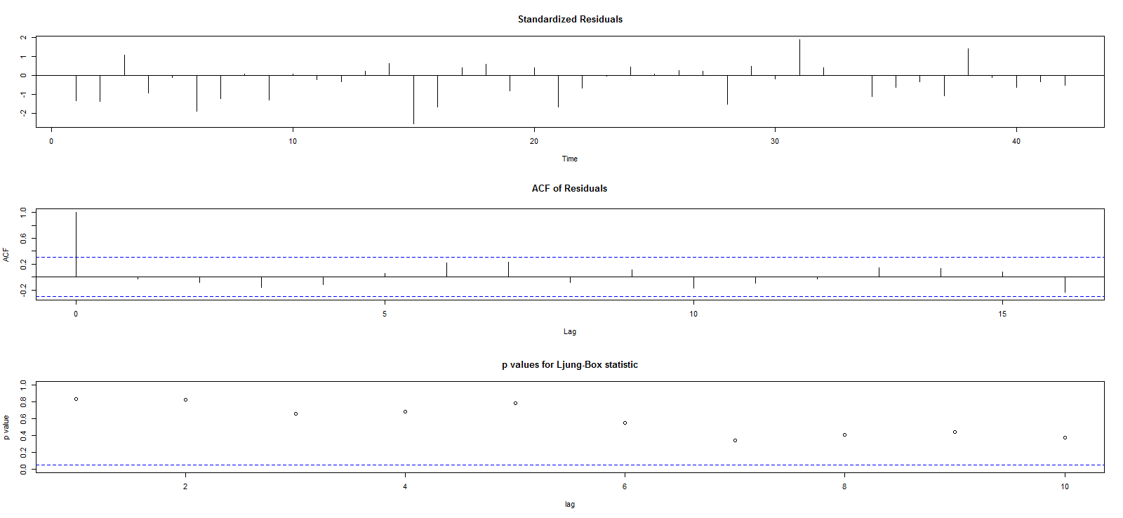
Model Plot : LATAM Consumer Profit(Check) Curve fitting Residue analysis

Slide 24
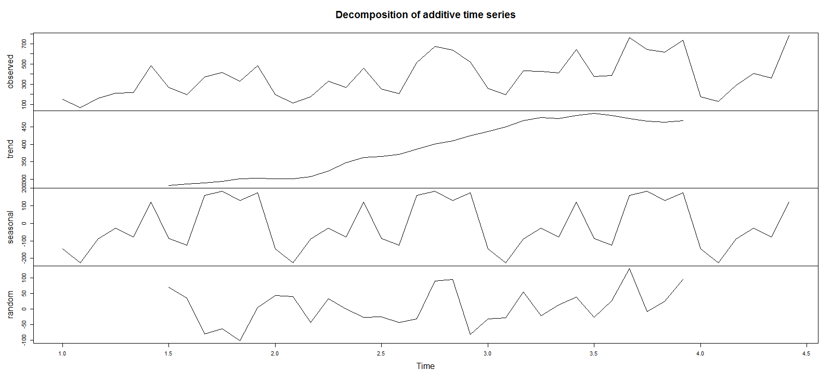
Model Plot : LATAM Consumer Quantity Decomposition Chart

Slide 25
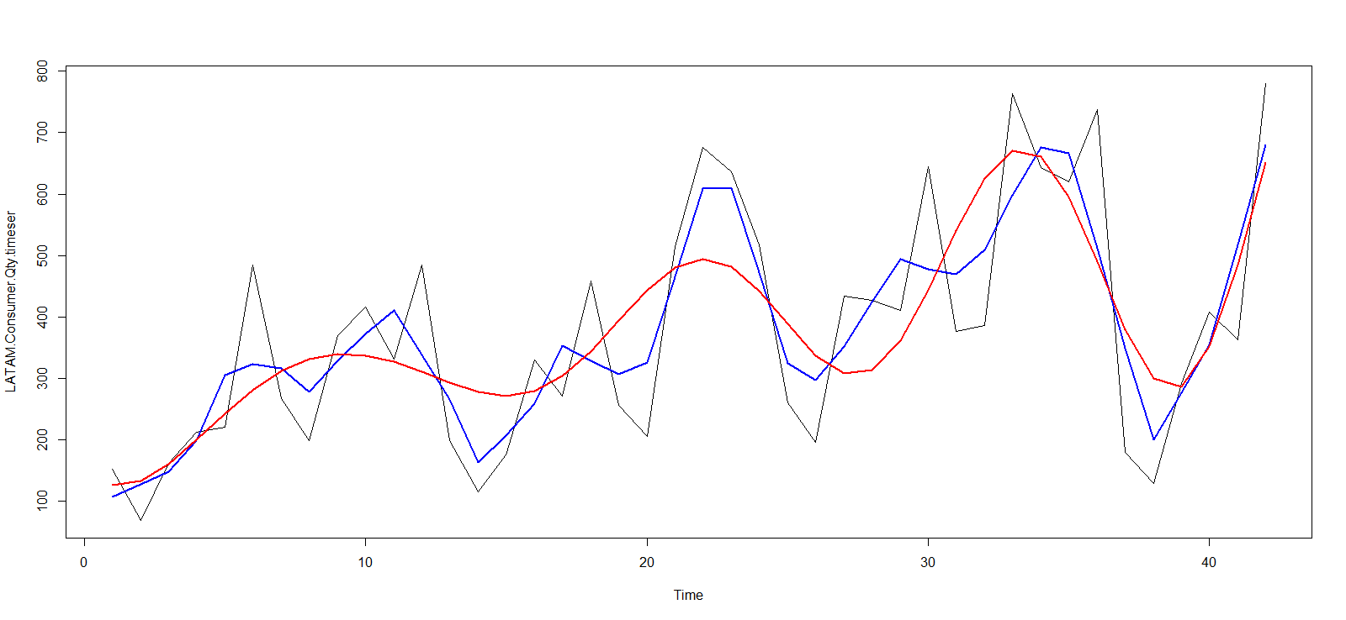

Model Plot : LATAM Consumer Quantity Curve fitting Residue analysis

Slide 26
Conclusions
Sales across all analysed market segments have shown seasonal behaviour
Segments that have shown linear increasing trend in quantity sold:
EU Consumer
EU Corporate
APAC Corporate
LATAM Consumer
All other trends show moderate cyclic behavior
LATAM Consumer quantity of sale has reached a plateau after a linear increase
focus on increasing the quantity of sales

